Slide 1
ECONOMY OF TURKEY
ECONOMY OF TURKEY

Slide 2
About GIZ
The services delivered by the Deutsche Gesellschaft für Internationale Zusammenarbeit (GIZ) GmbH draw on a wealth of regional and technical expertise and tried and tested management know-how. As a federal enterprise, they support the German Government in achieving its objectives in the field of international cooperation for sustainable development. They are also engaged in international education work around the globe.
GIZ offers demand-driven, tailor-made and effective services for sustainable development.
GIZ operates in many fields: economic development and employment promotion; governance and democracy; security, reconstruction, peacebuilding and civil conflict transformation; food security, health and basic education; and environmental protection, resource conservation and climate change mitigation. They also support their partners with management and logistical services, and act as an intermediary, balancing diverse interests in sensitive contexts.
Most of their work is commissioned by the German Federal Ministry for Economic Cooperation and Development. GIZ operates throughout Germany and in more than 130 countries worldwide.

Slide 3
About GIZ Training Program
This Program organized for representatives of companies of environmental technology, chemical industry, automotive suppliers, building industry and mechanical engineering to Turkey in order to investigate the possibilities for economic cooperation by the ministry for economics, climate protection, energy and land use planning of the State of Rhineland-Palatinate. To promote sustainable foreign trade relationships with industrial companies in Turkey, junior managers working in the area of is invited to Rhineland-Palatinate to participate in a two months training program. The offer includes qualified lectures, company visits and in-company internship for the participants.
The participants of this training program
improve their knowledge in business administration and enterprise management ( i. e. marketing and export promotion, environmental studies )
become acquainted with work procedures in German industries
have the possibility to get in contact with a German company
and the program supports the foreign trade relations between Rhineland-Palatinate and Turkey.

Slide 4
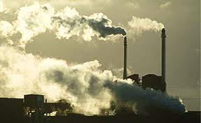
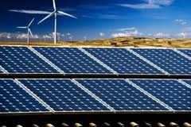
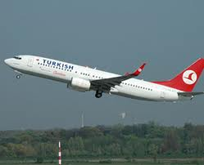
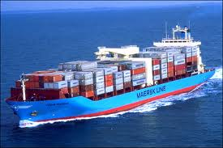
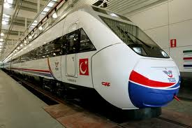
Economic Factors
Economic Factors

Slide 5
Agriculture
Animal Husbandry
Forestry
Mining
Energy Resources
Industry
Transporting
Tourism

Slide 6
Figures of Turkey Economy
The economy expanded by 8.5% in 2011, which shows Turkey is the Europe‘s fastest growing economy.
GDP per capita has rised to 10.444 $.
Capacity utiliyatiopn ratio realized as 74% in October 2012.
Debt/GDP ratio of Turkey was 39.4% in 2011, which was below the level in 21 EU Countries and the Maastricht Criteria (60%).
In July 2012, unemployment rate was %9.1
Turkey has a population of 74.7 million in which half of the population is under the age of 29.7.
Turkey’s share in global merchandise exports was %0.74 in 2011.

Slide 7
It is expected to take place in export is 149,5 billion $.
It is expected to take place in import is 239,5 billion $.
Turkey’s share in global exports of services was 0.92% in 2011.
31 out of the world‘s top 225 contracting companies are Turkish.
Turkey has the Europe‘s biggest truck fleet.
Turkey has the 25. biggest sea fleet in the world.

Slide 8
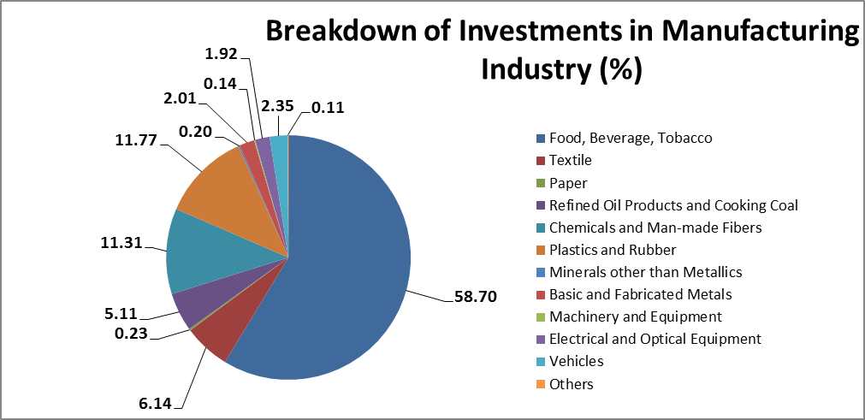
The Sectorel Breakdown of Foreign of Investments

Slide 9
Trade Between Germany and Turkey
Germany was Turkey’s 1st largest goods export market in 2011 with 597 sector.
Germany was Turkey’s 2nd largest supplier of goods in 2011.
Exports of goods to Germany amounted in 2011 13,9 billion $.
Imports of goods from Germany amounted 22,9 billion $.
Foreign direct investment (FDI) from Germany to Turkey FDI was 605 million $ in 2011.
Foreign direct investment (FDI) from Turkey to Germany was 91 million $ in 2011.

Slide 10
Export categories to Germany; articles of apparel and clothing accessories, road vehicles (including air-cushion vehicles), textile yarn, fabrics, made-up articles and related products, vegetables and fruit, power generating machinery and equipment.
Import categories from Germany; road vehicles (including air-cushion vehicles), machinery specialized for particular industries, general industrial machinery and equipment, and machine parts, electrical machinery, apparatus and appliances, and electrical parts there of (including non-electrical counterparts of electrical household-type equipment), power-generating machinery and equipment.

Slide 11
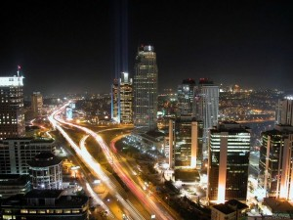
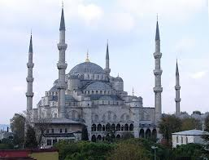
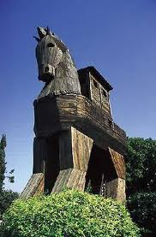
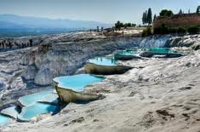
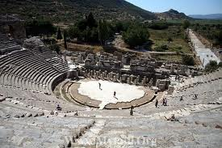

Slide 12
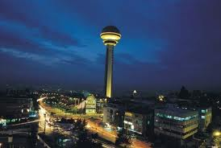
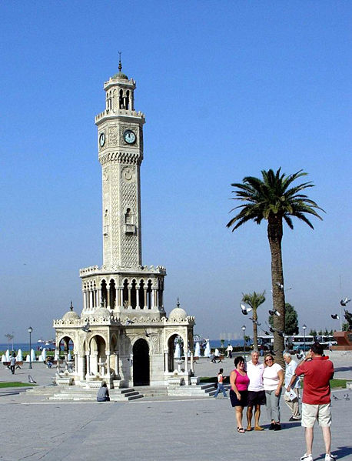
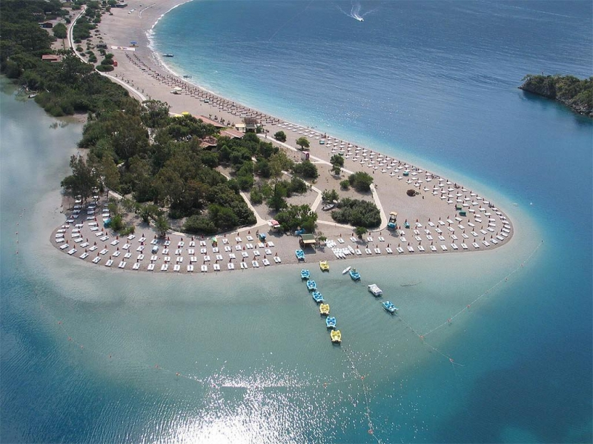
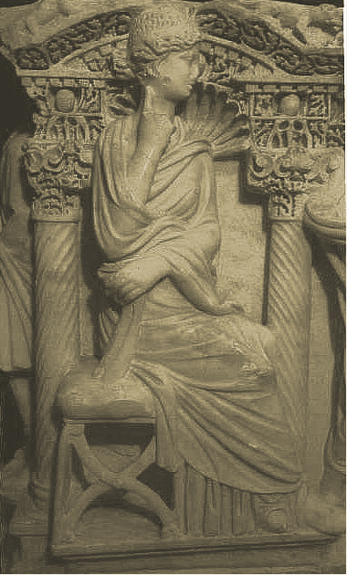
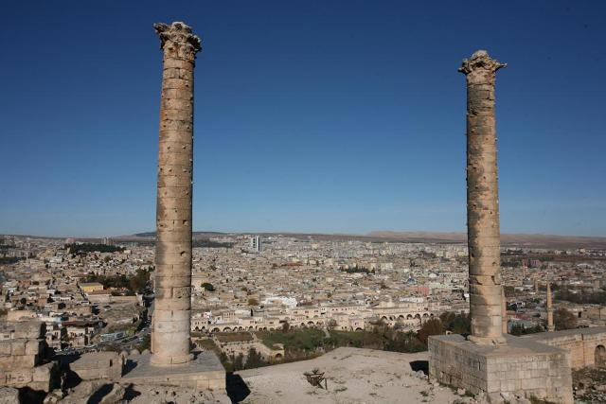
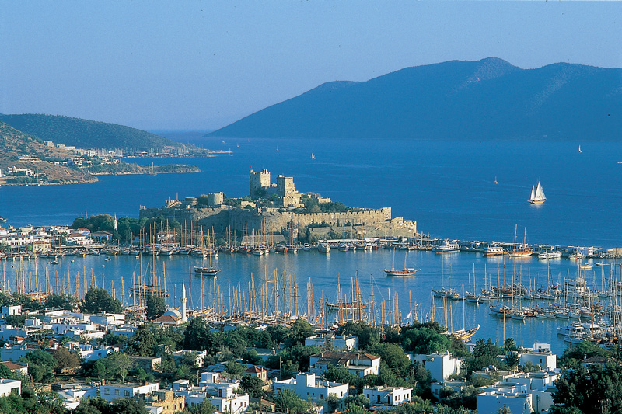

Slide 13
Thank you for your attention.
CAGIL CILEN OMAN
cilen_oman@hotmail.com

